Slide 1
Applying to College
Complete your application along with any other supplemental forms required.
Send your SAT and ACT scores to the college.
Request your transcript/recs through your Naviance account (login with your student email and your network password (what you use when you log into your computer).
These steps will be reviewed at your individual senior conference as well

Slide 2
The college application consists on many pieces.
Portfolio
Application
Interview
Essay
Transcript
SAT/ACT Scores
Recommendation Letters
Notes:
Testing testing testing one two three testing testing testing 1 2 3

Slide 3
Bayard Rustin CEEB CODE # 395167
You will use this code for:
-College Applications
-NCAA registration
-Sending college entrance exam scores to colleges---SAT I, II, AP and ACT’s
-Scholarships
Notes:
BARYARD RUSTIN HIGH SCHOOL
CEEB CODE #
395167
You will use this code on various forms during the college application process
You will also use it when having your college entrance exam scores sent to the colleges you apply to, the NCAA and/or for scholarship applications

Slide 4
Important information
We are on a weighted 4.0 grading scale
We DO NOT rank our students
Always give your weighted GPA unless a college specially asks for your unweighted GPA (very rare)
Transcripts will be run in mid-September. GPA could change. Wait to fill in your GPA until transcripts are finalized.

Slide 5
Overview of the College Application Process

Slide 6
Overview of the College Application Process
Request a transcript. This is done in Naviance (See below for directions). Do not request a transcript until you have finished your application or the application deadline is 15 school days away. Remember, we need 15 school days to process transcript requests.
Send in any supplemental materials that are needed for your application, such as Art Portfolios.
Many colleges will ask for updated senior grades throughout the year. Most colleges will ask for mid-year grades (end of the 2nd marking period). We will contact all seniors prior to the end of the 2nd marking period to see who needs to have their grades sent to colleges. If your college needs to see 1st or 3rd marking period grades, just ask you counselor. These are not as common, so we don’t reach out to the entire senior class.
If you add a new school to your list in Naviance after teachers have already sent their recommendation letters for you, you have to inform the teacher that you have added another school. Naviance will not do this for you.

Slide 7
Self Report Colleges
Self Report Colleges
Do not require a transcript with your initial application
You fill in the classes you took and grades you received on your application
Penn State and the University of Pittsburgh are examples of Self Report Schools
Do not request an initial transcript for Self Report schools. They will not look at it.

Slide 8
Self Report Colleges
Please refer to Parent Portal for completing Self-Report information where applicable.
a. Note: For "Seminar and Accelerated Honors", choose
"Accelerated"; for "Honors", choose "Honors";
For "Academic and CCP" choose "College Prep"
b. Go to the WCASD grading scales to convert your numeric grade (ie:
91%) to alphanumeric (ie: A-).
c. Round credits to the nearest .5 credit. (ie: 1.2 = 1; .4 = .5)
d. WCASD is on a weighted 4.0 grading scale.
***********Report weighted GPA unless unweighted GPA is specifically requested.

Slide 9
We require 15 school days to process all transcript and recommendation letter requests. Watch your deadlines. While we process applications as efficiently as possible, we cannot guarantee that your application deadline will be met if the required 15 school days are not given.

Slide 10
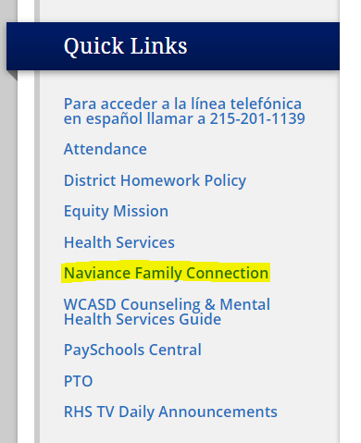
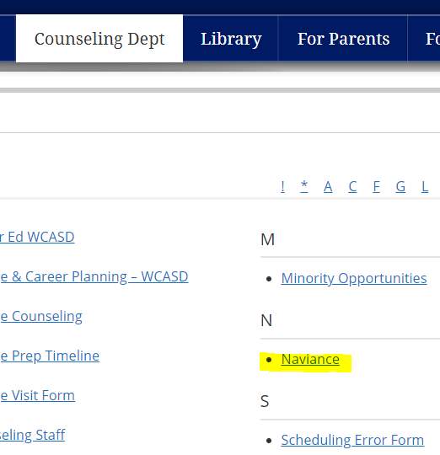
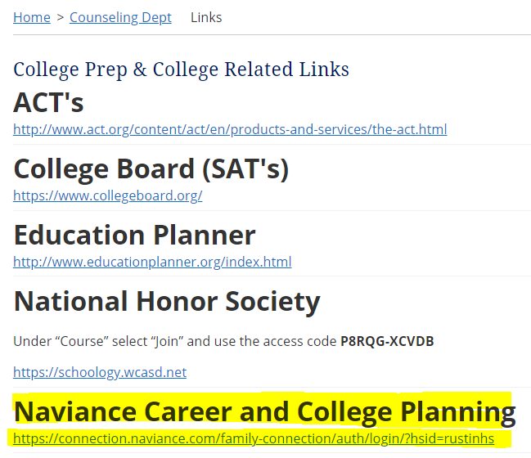
Three different Naviance log in Links
On the Rustin High School main page under Quick Links in the left hand column
On the Counseling Department main page under Naviance
In the links section of the Counseling Department main page

Slide 11
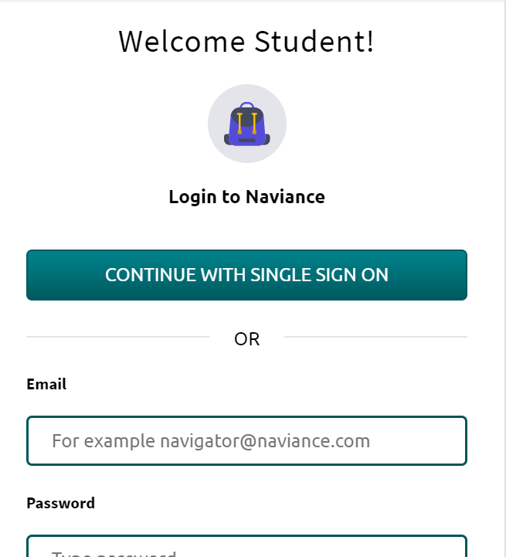
Click on CONTINUE WITH SINGLE SIGN ON

Slide 12
ID: This is wcasd\your WCASD user ID.
Password: Your password is the same password you use when you log into your computer.

Slide 13
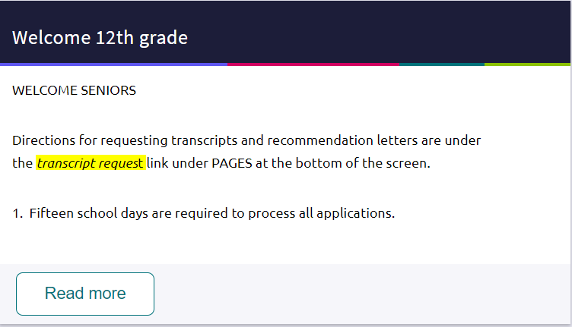
To request transcripts, click on Colleges I’m applying to
Notes:
Naviance Home Page

Slide 14
Common App and Naviance are two computer applications that work together to process your college applications. They must be able to “talk.” Match your common app and Naviance accounts.
Adding colleges to your queue by matching your Common App Account

Slide 15
Just fill in the email address you used on Common App and click Match Accounts. You must have completed the (CA) FERPA Waiver on Common App before matching accounts.
Once you match your Common App and Naviance accounts, Naviance will automatically import your colleges from Common App

Slide 16
In the Colleges I am applying to section: Click on the + sign on the right hand side of the page.
Adding Colleges to your que: Non Common App Colleges

Slide 17
Colleges I am applying to: Type in the name of the school. Click on Add application. Do not click on Request Transcript or I’ve submitted my application if you have not finished the application.

Slide 18
The colleges you add to your Naviance account will queue up in Colleges I’m applying to

Slide 19
When you are ready to request transcripts, you have to do 2 things for your request to show up in your Counselors’ Queue in Naviance
1. Request Transcript (see above) 2. Check that you finished your application (See Above)
*****If you don’t complete both steps, your Counselor will not be able to see your request in their queue on Naviance.

Slide 20
Requesting a Transcript
Click on the + Request transcripts button near the top of the page, then check the box for each school you are requesting a transcript for.

Slide 21
To mark that you completed your application, click on the EDIT button (See Below)

Slide 22
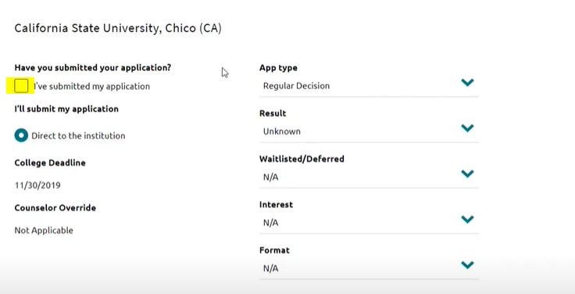
Now click on the box next to I’ve submitted my application

Slide 23
You will now see that under transcripts it says requested and under application it says submitted
Again, if both of these two steps are not completed, I will not know that you need a transcript to be sent!!!!

Slide 24
Teacher Recommendations
Go to the COLLEGES tab at the top of the page.
Under the APPLY TO COLLEGES block, click on LETTERS OF RECOMMENDATION
Click the ADD REQUEST button
Select the Teacher name, specify which colleges you want the letter sent to, include a personal note for the body of the email
Naviance will email the teacher with an invitation to add a recommendation letter to your Naviance account.

Slide 25
You can keep track of when teacher recommendation letters have been sent on this screen.
Choose whether you want a teacher to send their recommendation letter to all colleges on your list, or pick specific schools for each teacher.
If you add a college to your list after a teacher has written a recommendation letter for you, you must notify the teacher. Naviance will not notify the teacher that you have added a new college to your list.

Slide 26
We have a number of resources available on the Counseling Department website. Just click on Counseling Dept (see below) from Rustin’s main page.

Slide 27
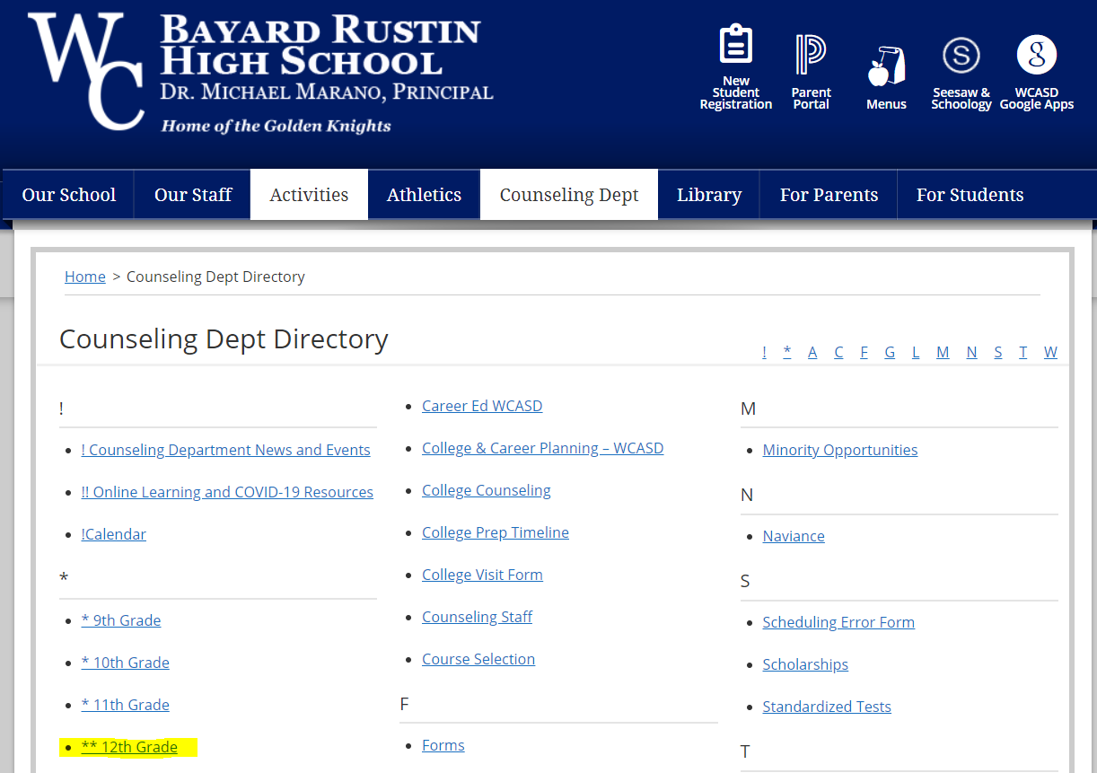
Choose the 12 Grade Folder on the next screen

Slide 28
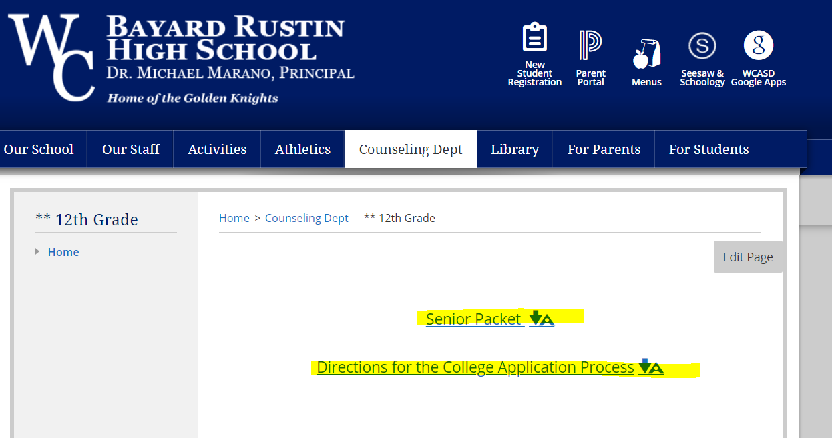
There are so many great resources on this page, including this presentation (Directions for the college application process) and our Senior Packet

Slide 29
Senior Conferences:
I will be meeting with each of you individually during the months of September and October
I have 64 seniors this year, so please make every effort to attend this meeting
I will schedule these meetings around both your schedule and my schedule
Parents are invited, but please let me know if they wish to attend. I cannot take special request times.
If you have a question, please come and see me. Don’t wait for your meeting.

Slide 30
Final Thoughts
If you are not finished your application and you are getting close to the 15 day school deadline, go ahead and request your transcripts and recommendation letters. Make sure you mark that you completed your application in Naviance, even though you may still be working on it.
We are here to help you. If a deadline is fast approaching, just come and talk to us. If you have any questions, please reach out to your Counselor.

